Slide 1
D* Lite and Dynamic pathfinding
Adrian Sotelo
CS582
Spring 2009 Digipen Institute of Technology

Slide 2
Traditional Pathfinding Algorithms
DFS
BFS
Dykstra’s
A*
Dykstra’s and A* will find an optimal path
If structure of the search space changes, the path needs to be recomputed from scratch
In real time applications this can be a problem with having to traverse deformable terrain
Also can be problematic if the structure of the search space is not known

Slide 3

Enter Dynamic Pathfinding
Be Water My Friend

Slide 4
Enter Dynamic Pathfinding (cont.)
Dynamic pathfinding algorithms will hold on to their search data.
If connections between nodes are lost or created, data is modified and only effected nodes are recalculated
No need to start from scratch

Slide 5
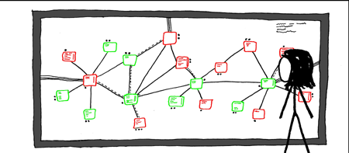
A* Refresher
Let’s review quickly how A* works.

Slide 6
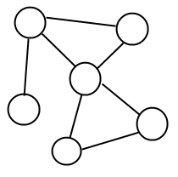
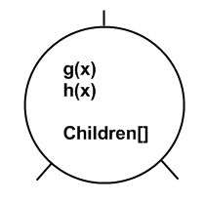

Data Structures
Graph
Node
Open List
Closed List

Slide 7
Node
g(x) is the cost so far from the start node to the current node
h(x) is the heuristic being used to estimate distance to the goal
Children[] is a list of children nodes or nodes connected to the current node

Slide 8
Open List
List of nodes that need to be examined
Priority Queue sorted by f(x)
f(x) = g(x) + h(x)

Slide 9
Closed List
List of nodes that have already been visited
List must also track the source parent of the nodes it contains
When the goal node is placed on the closed list the algorithm terminates

Slide 10
Algorithm
Openlist.Clear(); ClosedList.Clear();
currentNode = nil;
startNode.g(x) = 0;
Openlist.Push(startNode);
While currentNode != goalNode
currentNode = OpenList.Pop();
for each s in currentNode.Children[]
s.g(x) = currentNode.g(x) + c(currentNode, s);
OpenList.Push(s);
end for each
ClosedList.Push(currentNode);
End while

Slide 11

Now on to the Juicy stuff

Slide 12
Juicy Stuff (cont.)
Dynamic Pathfinding searches run the same basic algorithm.
However, when the search space is altered and costs are changed they’ll handle these inconsistencies.
How does the algorithm detect these inconsistencies?

Slide 13
RHS value
The answer lies in the introduction of a new value into the mix
This value is known as the Right Hand Side (rhs) value.
This value is equal to the cost to the parent of a node plus the cost to travel to that node
By comparing this value to the cost to the node we can detect inconsistencies

Slide 14
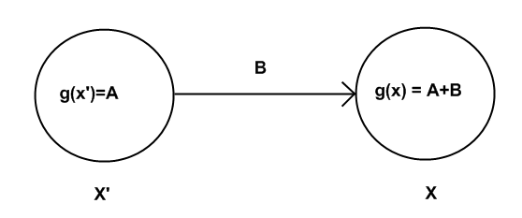
RHS Value (cont.)
g(x) = A+B
rhs(x) = g(x’) + c(x’,x) = A+B
Under normal circumstances g(x)==rhs(x)
This is known as locally consistent

Slide 15
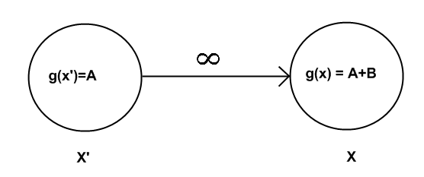
RHS Value (cont.)
Cost changed dynamically
g(x) = A+B
rhs(x) = g(x’)+c(x’,x) =A+∞ = ∞
g(x) != rhs(x)
This is called locally inconsistent

Slide 16
Inconsistency
The idea of inconsistency contains within it a lot of information both explicit and implicit that will be exploited in our search algorithms
Explicit data is used by the algorithm to update nodes. The implicit data will be used by the implementer to manage open lists.
Inconsistency falls into two categories: Underconsistency and Overconsisteny

Slide 17
Under Consistent
g(x) < rhs(x) is called underconsistency
When a node is found to be underconsistent that means that the path to the that node was made to be more expensive.
In a video game this would correspond to a wall or an obstruction was created
Nodes found to be underconsistent will need to be reset and paths completely recalculated

Slide 18
Over Consistent
g(x) > rhs(x) is called overconsistency
When a path is found to be overconsistent that means that the path to that node was made to be less expensive
In a video game this would mean that a shortcut was found or that an obstruction was cleared
In the following algorithms the idea of overconsistency is also used to manage the open list by exploiting the fact that an overconsistant node implies that the shortest path has been found to that node.

Slide 19
Lifelong Planning A* (LPA*)
This will be the first algorithm we explore as it is the foundation of D* Lite
The idea is that given a goal node you can find a path by backtracking to the start node by minimizing the rhs value.
Because of this we do not need to manage a Closed List (theoretically)

Slide 20
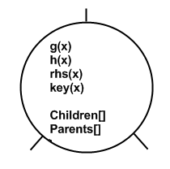
Data Structures
Graph
Node
OpenList

Slide 21
Node
g(x) is the cost so far from the start to the node
h(x) is the heuristic estimating the cost from x to the goal
rhs(x) = min(g(x’)+c(x’,x)) where x’ are the parents of x
key(x) is a value used to sort the open list
Children[] is a list of node that can be advanced to from x
Parents[] is a list of nodes from which you can advance to x

Slide 22
The Key
As mentioned before the key of a node is a value that is going to be used to sort the open list by
The key is a touple value = [min(g(x),rhs(x)+h(x)); min(g(x),rhs(s)]
These Keys are compared lexicographically So u < v if (u.first < v.first OR u.first == v.first AND u.second < v.second)
More on this later

Slide 23
The Open List
Priority Queue Sorted by Key Value
All nodes in the Open List are locally inconsistent
All locally inconsistent nodes are on the open list

Slide 24
The Algorithm (general)
For each s in Graph
s.g(x) = rhs(x) = ∞; (locally consistent)
end for each
startNode.rhs = 0; (overconsistent)
Forever
While(OpenList.Top().key<goal.key OR
goal is incosistent)
currentNode=OpenList.Pop();
if(currentNode is overconsistent)
currentNode.g(x) = currentNode.rhs(x); (Consistent)
else
currentNode.g(x)= ∞; (overconsistent OR consistent)
end if
for each s in currentNode.Children[]
update s.rhs(x); (consistent OR inconsistent)
end for each
End while
Wait for changes in Graph
For each connection (u, v) with changed cost
Update connection(u, v);
Make v locally inconsistent;
end for each
End forever

Slide 25
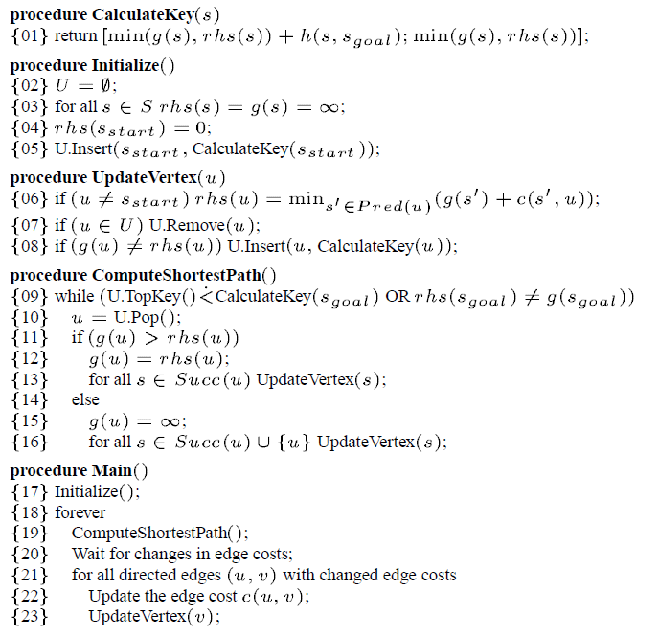
The Algorithm (More Specific)

Slide 26
Similar to A*
ComputeShortestPath() runs that same as A* when there are no changes to the Graph
Only when when changes occur do inconsistencies come into play
Notice that this algorithm is constantly checking for changes in the graph that means that the OpenList is never reset and anytime ComputeShortestPath() is called the openlist still contains all the previous locally inconsistent nodes as well as the new nodes recently made inconsistent by the changes in the Graph

Slide 27
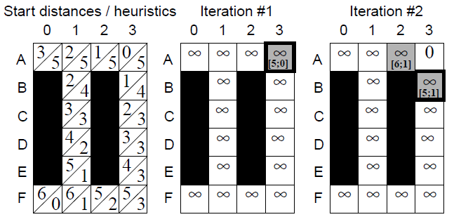
Demonstration

Slide 28
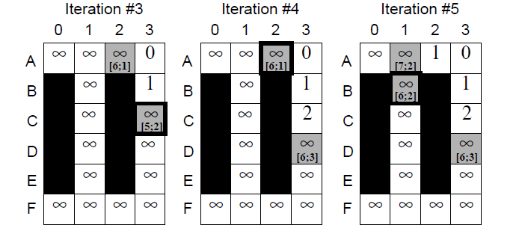
Demonstation

Slide 29
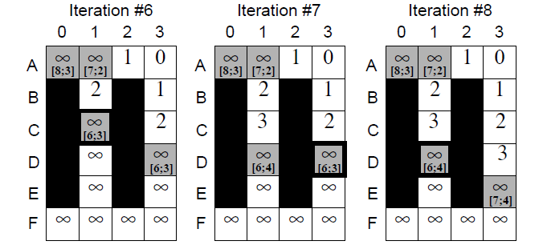
Deomstration

Slide 30
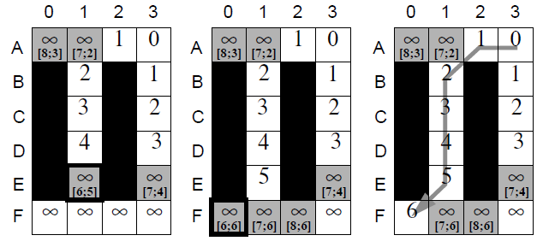
Demonstration

Slide 31
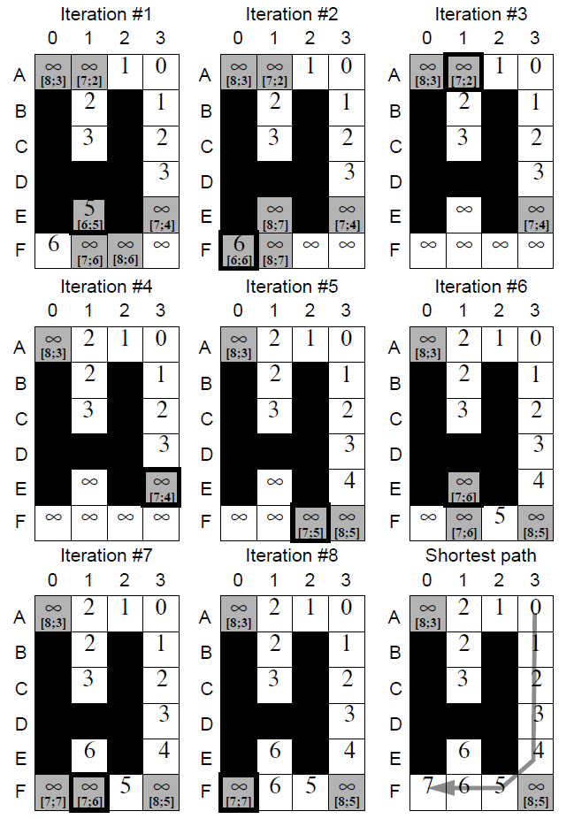
Second Search Demonstration

Slide 32
LPA* weaknesses
Is only recalculating from a single start, goal pair.
What if we have already advanced when the Graph changes?
Good for calculating paths at some monitored location, but not good for handling changes while traveling

Slide 33
D* Lite
Built on top of LPA*
Takes into consideration path already traveled
How does it do this?

Slide 34
D* Lite
Heap reordering
D* Lite will find the shortest path from the goal node to the start node by minimizing rhs values
Key values are updated when a connection changes not only with the new connection data, but with the new amount the agent has traveled

Slide 35
K value
As an agent advances along the path the start node becomes the current node the agent is on
So when connections change and keys need to be calculated we need to update the heuristic from being estimated cost from goal to original start to estimated cost from goal node to new start

Slide 36
K value (cont.)
Because we’re moving toward the goal the heuristic will be decreasing
This decrease can be no more than h(startOrg, startNew). This is due to the propery of the heuristic being derived from a relaxed version of the problem.
So subtract that value from all keys?

Slide 37
K Value (Cont.*)
Because the we’re subtracting the same value from all keys the order in the Priority Queue does not change.
So Instead why don’t we add that value to all new calculated keys
This way we avoid traversing the Queue everytime connections change and heuristics remain admissible

Slide 38
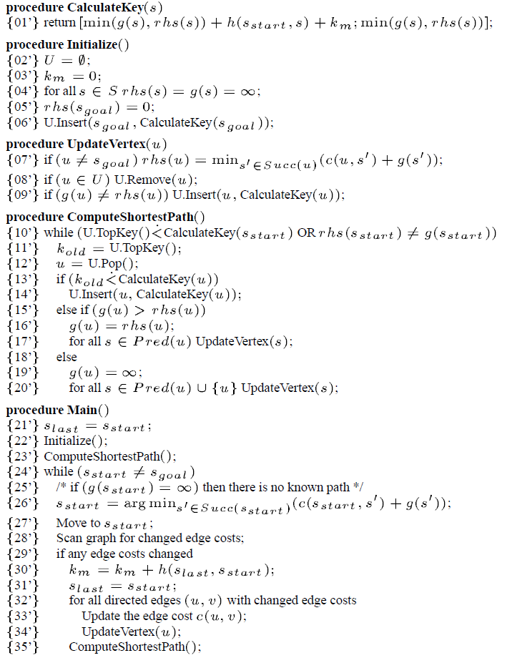
The Algorithm

Slide 39
Questions?

